Slide 1
TOPIC 4
Chapter:13
The Costs

Slide 2
Total Revenue, Total Cost, and Profit
Total Revenue
  The amount a firm receives for the sale of its output.
Total Cost
  The market value of the inputs a firm uses in production.

Slide 3
Total Revenue, Total Cost, and Profit
Profit is the firm’s total revenue minus its total cost.
Profit = Total revenue - Total cost

Slide 4
Costs as Opportunity Costs
A firm’s cost of production includes all the opportunity costs of making its output of goods and services.

Slide 5
THE VARIOUS MEASURES OF COST
Everywhere that production goes, costs follow close behind like a shadow.
Costs of production may be divided into fixed costs and variable costs.
Fixed costs are those costs that do not vary with the quantity of output produced.
Variable costs are those costs that do vary with the quantity of output produced

Slide 6
Average Costs
  Average costs can be determined by dividing the firm’s costs by the quantity of output it produces.
  The average cost is the cost of each typical unit of product.
  Average Fixed Costs (AFC)
  Average Variable Costs (AVC)
  Average Total Costs (ATC)
  ATC = AFC + AVC

Slide 7
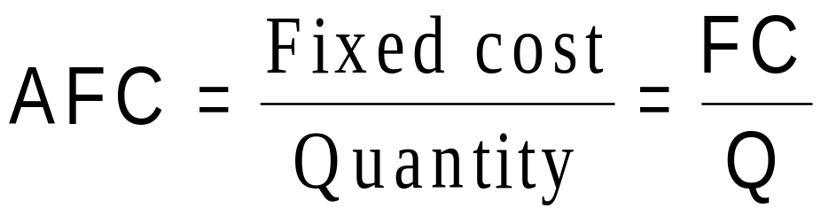
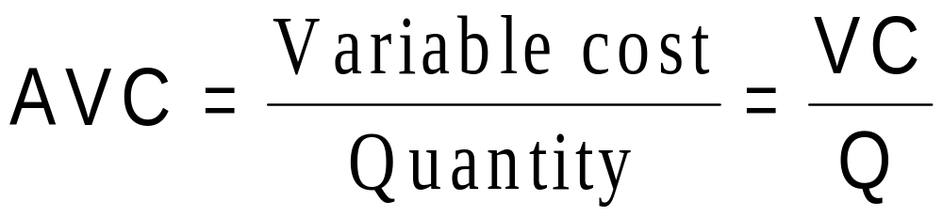
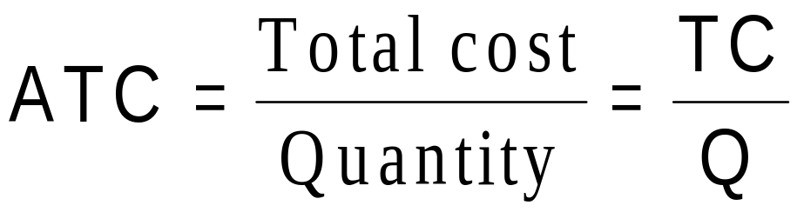
Average Costs

Slide 8
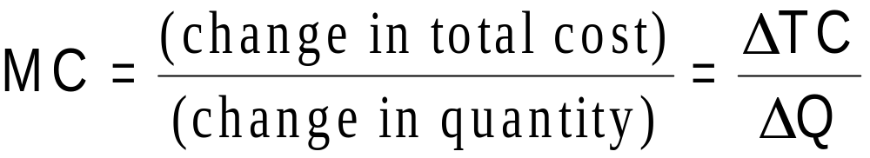
Marginal Cost
  Marginal cost (MC) measures the increase in total cost that arises from an extra unit of production.
  Marginal cost helps answer the following question:
    How much does it cost to produce an additional unit of output?

Slide 9
Cost Curves and Their Shapes
The average total-cost curve is U-shaped.
At very low levels of output average total cost is high because fixed cost is spread over only a few units.
Average total cost declines as output increases.
Average total cost starts rising because average variable cost rises substantially.

Slide 10
Cost Curves and Their Shapes
The bottom of the U-shaped ATC curve occurs at the quantity that minimizes average total cost. This quantity is sometimes called the efficient scale of the firm.

Slide 11

Figure :Average-Cost and Marginal-Cost Curves
Costs
$3.50
3.25
3.00
2.75
2.50
2.25
MC
2.00
1.75
1.50
ATC
1.25
1.00
0.75
0.50
0.25
0
1
2
3
4
5
6
7
8
9
10
Quantity
of Output
(glasses of lemonade per hour)
Copyright © 2004 South-Western

Slide 12
Cost Curves and Their Shapes
Relationship between Marginal Cost and Average Total Cost
  Whenever marginal cost is less than average total cost, average total cost is falling.
  Whenever marginal cost is greater than average total cost, average total cost is rising.
  The marginal-cost curve crosses the average-total-cost curve at the efficient scale.
    Efficient scale is the quantity that minimizes average total cost.

Slide 13
COSTS IN THE SHORT RUN AND IN THE LONG RUN
For many firms, the division of total costs between fixed and variable costs depends on the time horizon being considered.
  In the short run, some costs are fixed.
  In the long run, fixed costs become variable costs.

